Slide 1
Node JS
S.Karthiga,
Assistant Professor,
Department of IT, TCE

Slide 2
Session Outcomes
At the end of this session, students will be able to,
Describe about the purpose of Nodes JS
Install Node JS and Test Simple App

Slide 3
Node Js
Node.js is an open-source, cross-platform, JavaScript runtime environment that executes JavaScript code outside a web browser.
Support for Back-end Programming
Non blocking
Event driven Programming
Work on runtime environment
Suitable for highly scalable application
Super fast – Response
Java Script - Code
More libraries available

Slide 4
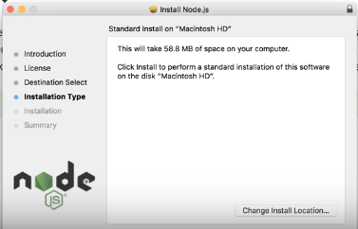
Download and Install – Node JS

Slide 5
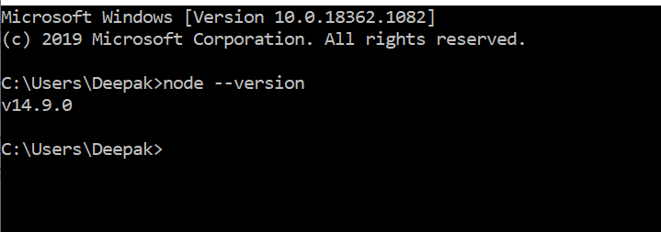
Check the installation

Slide 6
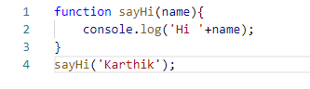
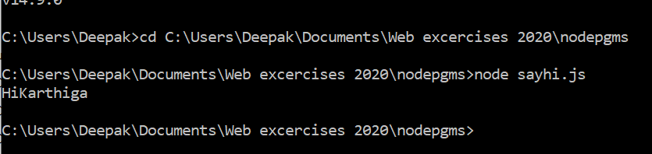
app.js File and Output
sayhi.js

Slide 7
Demo

